Slide 1
Cache Memory
Mapping Function

Slide 2
Set Associative Mapping
The cache is divided into I set, each set consists of J slots.
We have C=I×J
C: Total no. of slots in cache
I: No. of the set in cache.
J: No. of slots in each set.
K= A modulo I
K: Cache set no.
A: Block address (block No. coming from main memory)
With this algorithm, the block containing address A can be mapped into any slot in set I.
If I=C, J=1 the set associative technique reduces to direct mapping and for I=1, j=C, it reduces to associative mapping.

Slide 3
Set Associative Mapping
For example, if the no. of slots =2 in each set, then the no. of set is 128/2 =64 set in cache.
Any coming block from main memory will be mapped into anyone of 2 slots in specified set. The set will be specified by using:
K=A module I
Block0 K= 0modulo 64 K=0
Block1 K= 1modulo 64 K=1
Block63 K= 63modulo 64 K=63
Block64 K= 64 modulo 64 K=0
Therefore
Blocks 0,64,128,192,…………. Mapping on set 0
Blocks 1,65,129,193,…………..Mapping on set 1
:
Blocks 63,127,191,….…,8191 Mapping on set 63

Slide 4
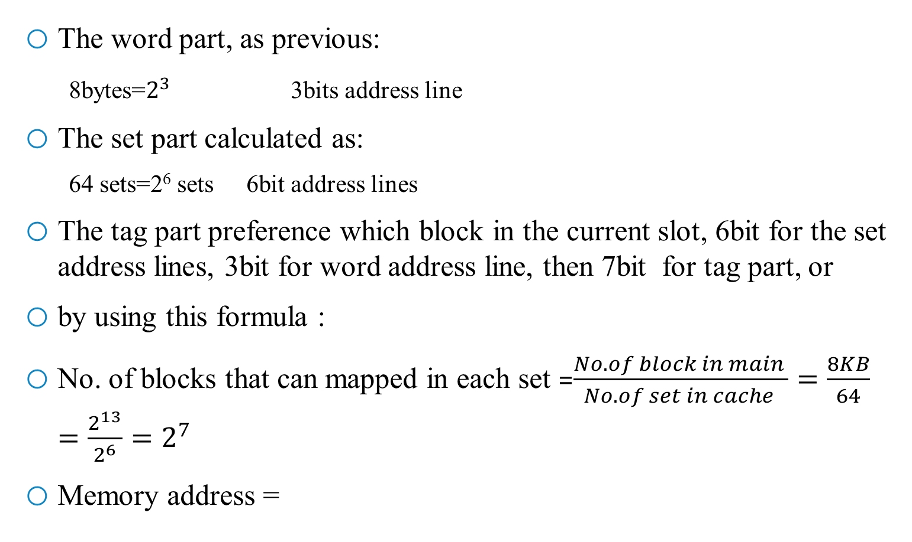
Set Associative Mapping
The word part, as previous:
8bytes=$2^{3}$ 3bits address line
The set part calculated as:
64 sets=2⁶ sets 6bit address lines
The tag part preference which block in the current slot, 6bit for the set address lines, 3bit for word address line, then 7bit for tag part, or
by using this formula :
No. of blocks that can mapped in each set =$\frac{No. of block in main }{No.of set in cache }=\frac{8KB}{64}=\frac{2^{13}}{2^{6}}=2^{7}$
Memory address =
Word | Set | Tag

Slide 5
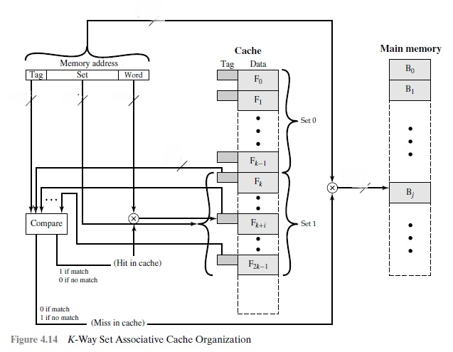
Set Associative Mapping

Slide 6
Replacement Algorithms
Once the cache has been filled, when a new block is brought into the cache, one of the existing blocks must be replaced.
Direct mapping, there is only one possible line for any particular block, and no choice is possible.
Associative and set associative techniques, a replacement algorithm is needed.
Least recently used (LRU): Replace that block in the set that has been in the cache longest with no reference to it.
First-in-first-out (FIFO): Replace that block in the set that has been in the cache longest.
Least frequently used (LFU): Replace that block in the set that has experienced the fewest references.
Random replacement: is to pick a line at random from among the candidate lines.

